Slide 1
DS5110 Introduction to Data Management and Processing Final Proejct
Retail Store Database and analysis (Big Data System)
Cheng Shi
Daniel Xiong
Manish Kanuri

Slide 2
Introduction
Topic:
Managing a Retail Store Database and Analysis (Big Data System)
Project Scope:
This project is about designing a database system for managing a retail store, including product inventory, sales transactions, and marketing data.
Then, Retrieve raw data from multiple resources and import it into the database after cleaning and parsing.
In the end, Build visualizations and dashboards for insight and analysis. such as Sales Performance Evaluation and Employee Performance or Inventory Management Dashboard.

Slide 3
Teams and Roles
Cheng Shi: Database Schema Design, Importing Data, Web App
Daniel Xiong: Data Parsing, Information Retrieval, Data Cleaning
Manish Kanuri: Data Analysis, Visualization, Report

Slide 4
Development Plan
Phase 1: Design DB initial Schema
Phase 2: Retrieve and observe Raw Data and finalize DB structure.
Phase 3: Import Data after cleaning and parsing.
Phase 4: Analysis and visualization for insight.
Phase 5: Build website to showcase.

Slide 5
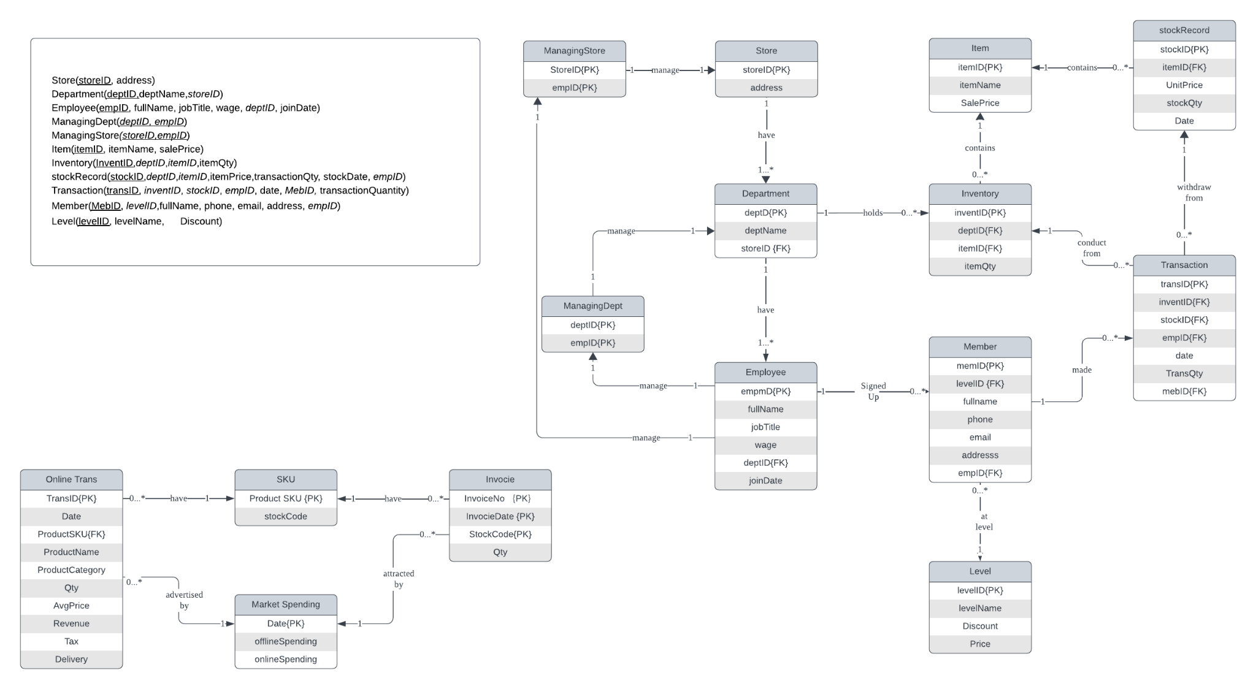
Initial Schema

Slide 6
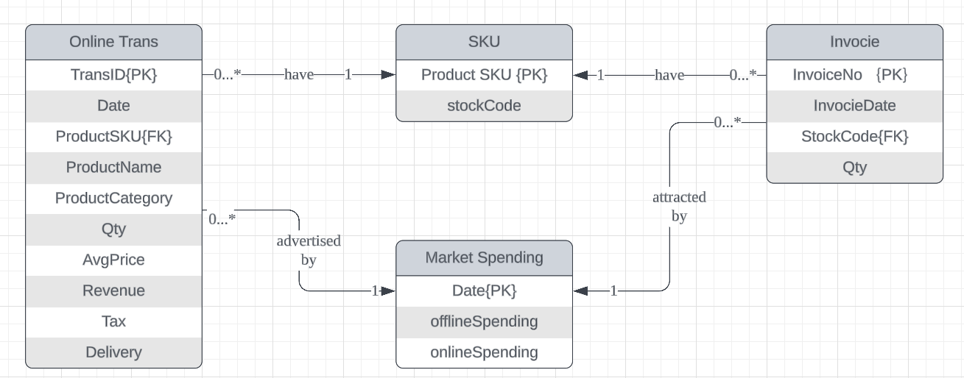
Finalized Schema

Slide 7
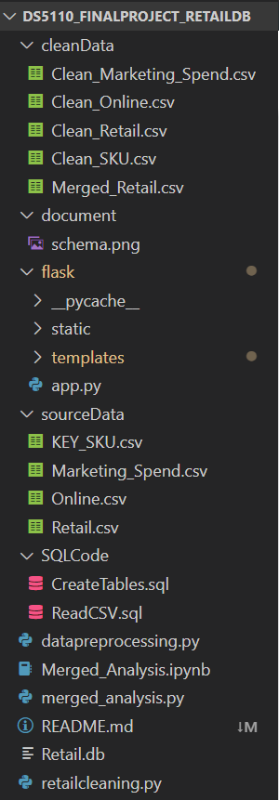
Methodology
Tech Stack:
Github
SQLite
Jupyter Notebook
Python
Flask
Python libraries include: Pandas
Seaborn
Matplotlib
Flask

Slide 8
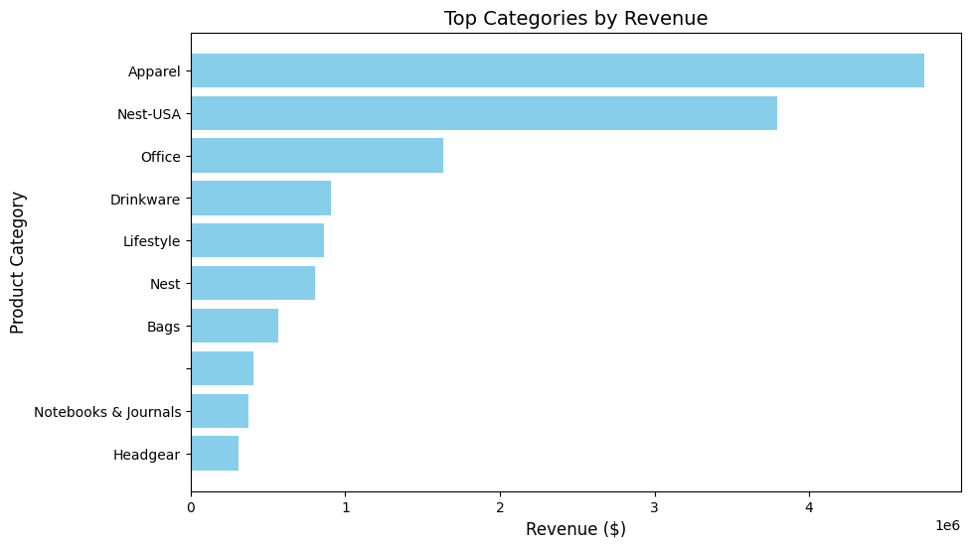
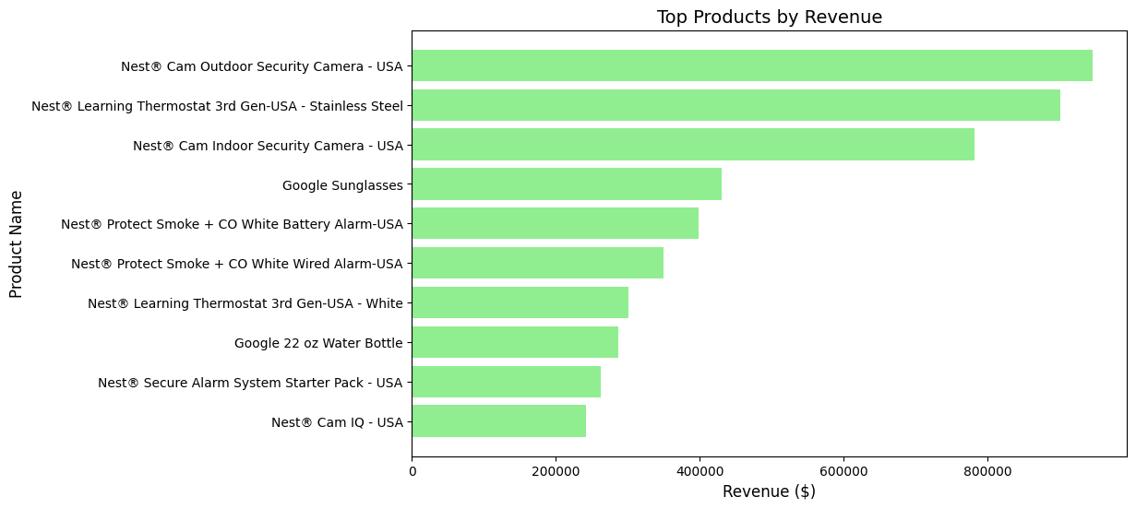
Analysis and Results:
1. Revenue Analysis (Top Categories/Products by Revenue)
This can be seen from the bar graph on the highest revenue generating products , where the Nest® Cam Outdoor Security Camera – USA received revenue of more than $800,000, Nest® Learning Thermostat 3rd Gen – Stainless Steel and, Nest® Cam Indoor Security Camera – USA indicating a growing market in home security and automation. The Google Sunglasses and Nest® Protect Smoke + CO Alarms contribute moderately and products with lower revenues like Google 22 oz Water Bottle, Nest® Cam IQ – USA also make the list. This means that some categories should be targeted based on the fact that they are smart home products while the middle performers present more chance to expand by implementing certain tactics.
Ranking by revenue of the various product categories has been represented graphically using a bar graph whereby Apparel emerged as the most lucrative segment earning more than $4 million followed by Nest-USA. While these two categories act as super-categories that garner the greatest sales, others such as Office, Drinkware and Lifestyle categories attract medium sales. The Notebooks & Journals and Headgear categories generate comparatively small revenues are at the lower end of the company’s performance spectrum. This increases Apparel’s market share and points towards the idea of value creation strategy pertaining to the top categories and considering how to increase the sales of the weak categories.

Slide 9
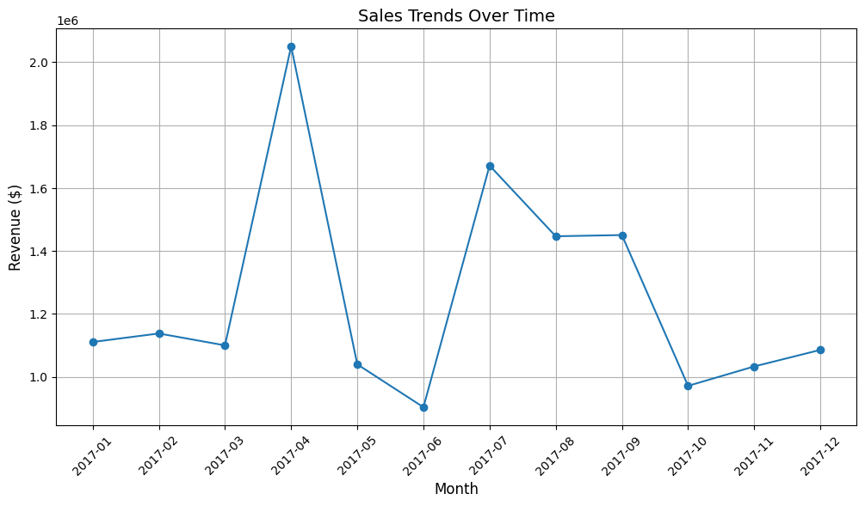
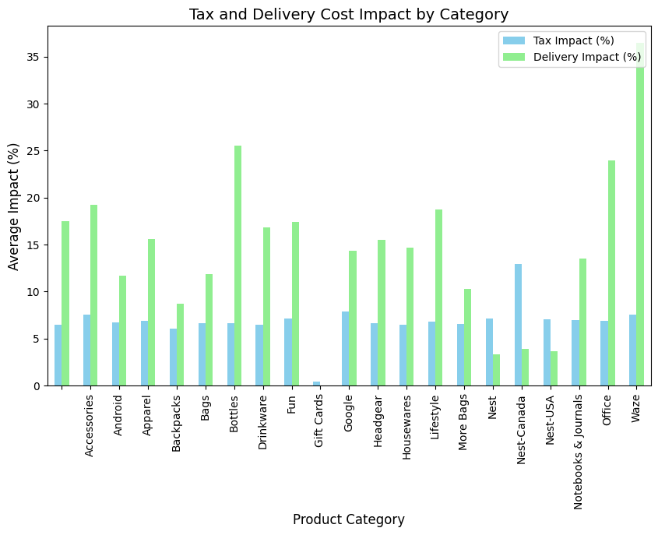
2. Sales Trends Over Time
3. Tax and Delivery Cost Impact
The line graph represents **monthly sales revenue for the year 2017** depicting the amount of sales in each month. For **April**, there is a sharp increase in revenues to just over $2 million, this may probably be as a result of promotions or seasonal factors. By reef or fall, then, revenue falls in **May** before rising again in **July**, and tapering off towards the end of the year, or **October**. Lastly, **November and December** presumably due to holiday seasons may record a slightly higher sales than the end of the month figure. These trends show the potential of increasing loads during the crowd months such as April and July while managing the low months using special measures.
The chart compares the average tax and delivery cost impacts (%) across various product categories. It shows that delivery costs (green bars) generally have a higher impact than tax costs (blue bars) for most categories. Categories like "Bottles" and "Waze" experience significantly high delivery impacts, while others like "Gift Cards" show negligible impacts. This highlights variations in cost burdens across product types, emphasizing delivery's prominent role in the overall cost structure.

Slide 10
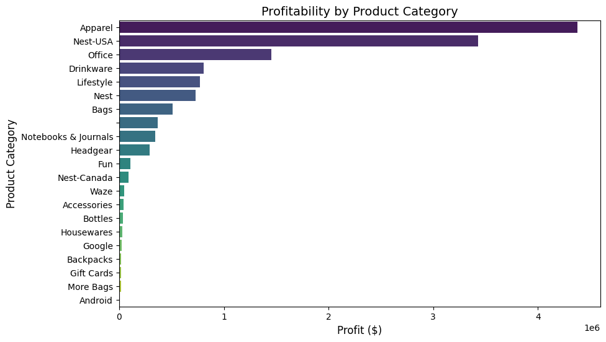
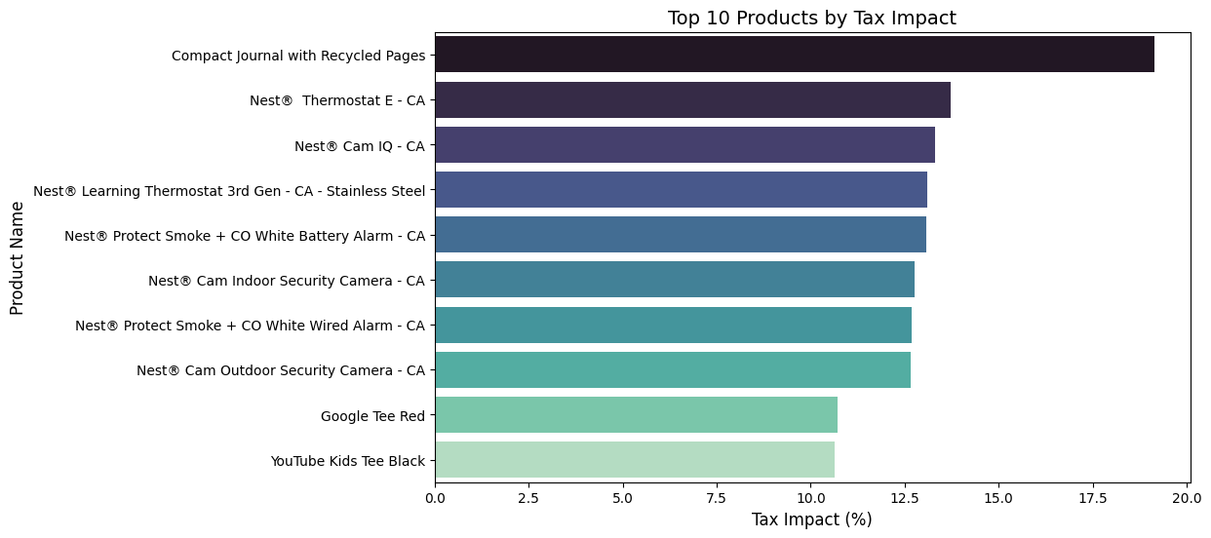
4. Profitability Analysis
5.High-Tax Impact Products
The omnibus horizontal bar chart above shows the amount of dollars which defines the product categories chosen as profitable. When it comes to profit, “Apparel” is ranked the highest having a much higher profit than the other categories, “Nest-USA,” “Office“, has the next highest profits. I find products with moderate profitability in some categories like “Drinkware,” “Lifestyle,” and “Nest,” whereas others like “Waze,” “Accessories,” and “Android” bring little to the bottom line. What is more, it underlines concentration of many companies within several broadband categories thus implying that these categories may be a key concern for the firms with regard to their income generation and business strategy.
The horizontal bar chart then categorizes the revenue by products according to the percentage of tax impact. The Compact Journal with Recycled Pages has the highest tax impact and is set significantly apart from the rest of the products. In order immediately following several Nest® products including the “Thermostat E,” “Cam IQ,” and “Learning Thermostat 3rd Gen,” which ranked do account for relatively high tax percent. Also, two products – Google Tee Red and the YouTube Kids Tee Black are the product least technologically with their tax impacts slightly over 10% and forming part of the top ten products. This chart shows the best way that particular products for example those manufactured under the Nest® brand in particular are subjected to a higher tax levels.

Slide 11
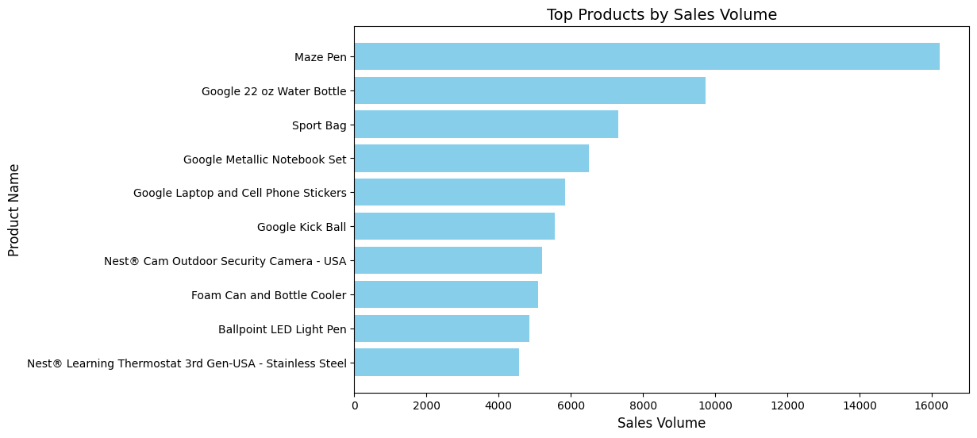
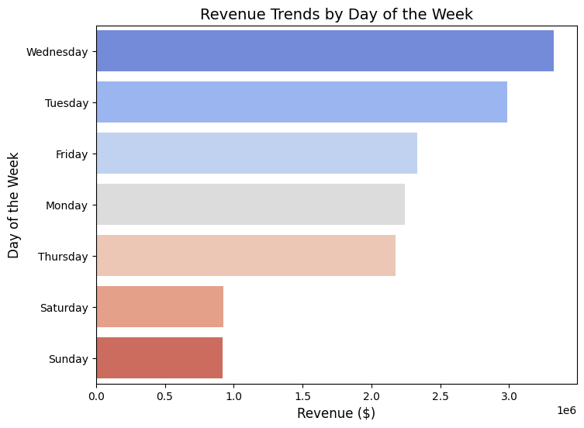
6. Revenue by Day of the Week
7.Top Products by Sales Volume
The second graphic type is the horizontal bar chart, which shows day by day revenue and suggests weekly fluctuations in business activity. Studied days show that Wednesday yields the highest revenues of approximately $3,500,000 while Tuesday yields about $3 million. Friday and Monday exhibit almost the same sales; both days totaling $2.5 million worth of sales created. Thursday undergoes the same level of overall revenue as does Monday and Friday. : Revenue is extremely low during the weekends; Saturday and Sunday recorded slightly over $1 million, which is way less than a third of what was generated on Wednesday. To show the revenue patterns, the color coding in the graph uses blue shades for days that scored the highest performances, gray for the second best and top red tones for the worst performers, thus making comparisons easy.
The bar chart highlights the top-selling products by sales volume. The Maze Pen leads with around 16,000 units sold, followed by the Google 22 oz Water Bottle at over 12,000 units. Other notable products, including the Sport Bag, Google Metallic Notebook Set, and Google Laptop and Cell Phone Stickers, achieve sales between 6,000 and 10,000 units. The remaining items, such as the Ballpoint LED Light Pen and Nest Learning Thermostat, show modest sales of over 4,000 units.

Slide 12
Discussion
Top Categories by Revenue:
Electronics leads with $500,000, followed by Home ($300,000) and Fashion ($250,000).
These categories contribute significantly to overall revenue, with Electronics alone representing over a third of the revenue.
Top Products by Revenue:
The most profitable product is the Smartphone ($500,000), followed by Vacuum Cleaner ($300,000) and T-Shirt ($250,000).
These products highlight the importance of focusing on high-value and high-demand items.
Revenue Distribution:
The top 10% of products contribute 57.1% of the total revenue, showing a high dependency on a small fraction of products.
The top 50% of products account for the entirety of the revenue, emphasizing the Pareto principle in sales.

Slide 13
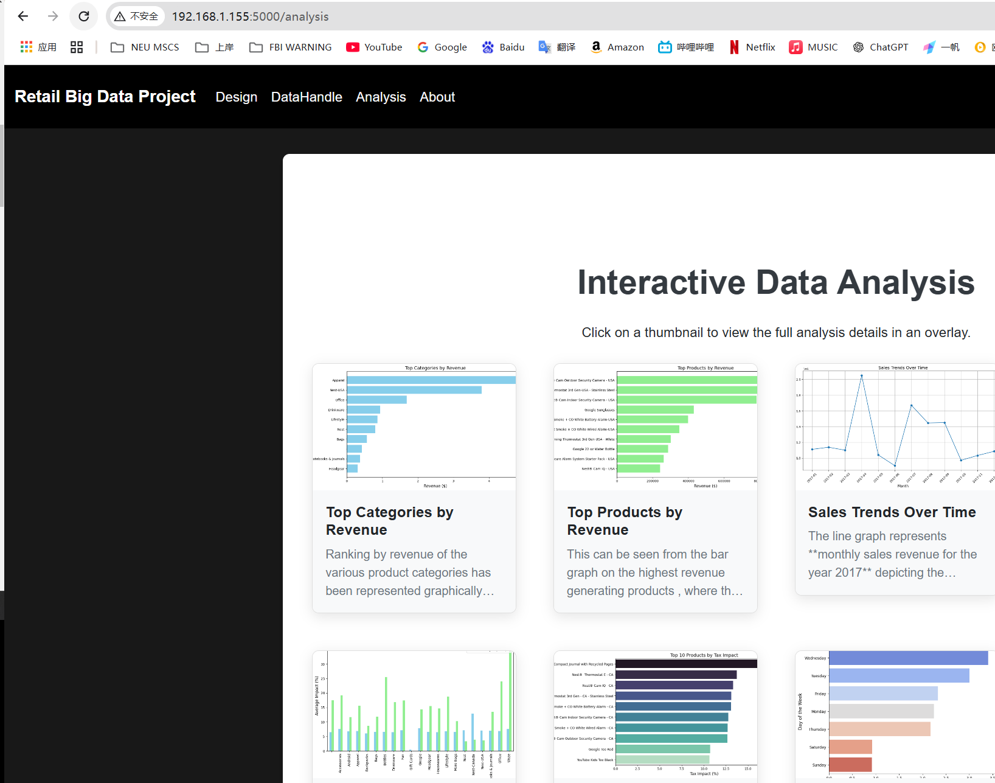
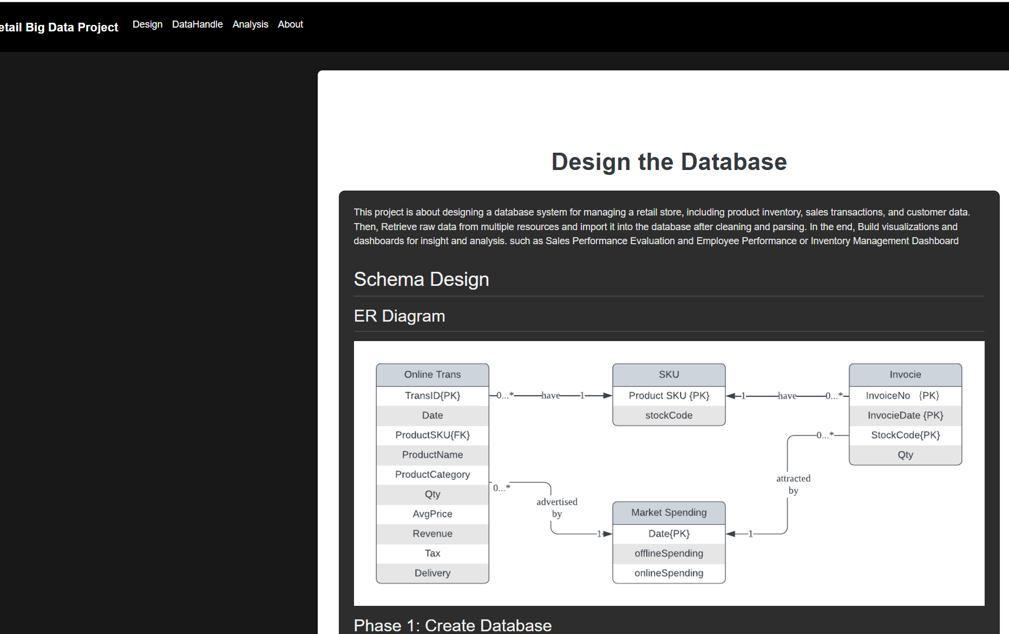
Website

Slide 14
Conclusion
This project successfully demonstrates the end-to-end process of building a robust retail store database and deriving actionable insights from the data.
By integrating data cleaning, schema design, and insightful visualizations, the team showcased the potential of database systems in streamlining inventory management, evaluating sales performance, and identifying profitability drivers.
The project also highlights the importance of collaborative teamwork, effective use of Python tools, and creating a user-friendly web interface to present the results.

Slide 15
Future Recommandation
Real-Time Data Integration: Introduce real-time data collection and updates for inventory and sales to make the system more dynamic. This can be achieved using tools like Kafka for streaming data and PostgreSQL for real-time database updates.
Advanced Analytics: Incorporate machine learning models to forecast sales, recommend inventory restocking, and predict customer preferences. Libraries like TensorFlow or Scikit-learn can assist with predictive analytics.
Enhanced Scalability: Move from SQLite to a more scalable database like PostgreSQL or MongoDB, especially if handling larger datasets or requiring concurrent access.

Slide 16
References
Project github:
https://github.com/sc971008/DS5110_FinalProject_RetailDB
SourceData: https://www.kaggle.com/datasets/jpallard/google-store-ecommerce-data-fake-retail-data?select=Online.csv%EF%BC%89
Project website:
https://100.0.195.180:5000/about

